Slide 1
Divide and Conquer Algorithms

Slide 2
The idea behind divide an conquer algorithms
Step #1: Do a small bit of work
Step #2: Recursively call that does same work on a subset of original data
Final Step (sometimes): Recombine results from all recursive calls into end solution.

Slide 3
A very easy (!!?) example
void search(int *sorted_list, int size, int to_find){
int index = size / 2;
if(size == 0)
return -1;
if(sorted_list[index] == to_find)
return index;
else if(sorted_list[index] > to_find)
return search( &sorted_list[index + 1], index - 1, to_find);
else
return search(sorted_list, index, to_find);
}

Slide 4
Analyzing Binary Search Approach #1
Brute force approach: count # of steps taken for differing input size, infer growth rate.
N | # Steps
1
2
4
6
8
10
12
14
16

Slide 5
Analyzing Binary Search Approach #2: Building a recursion tree

Slide 6
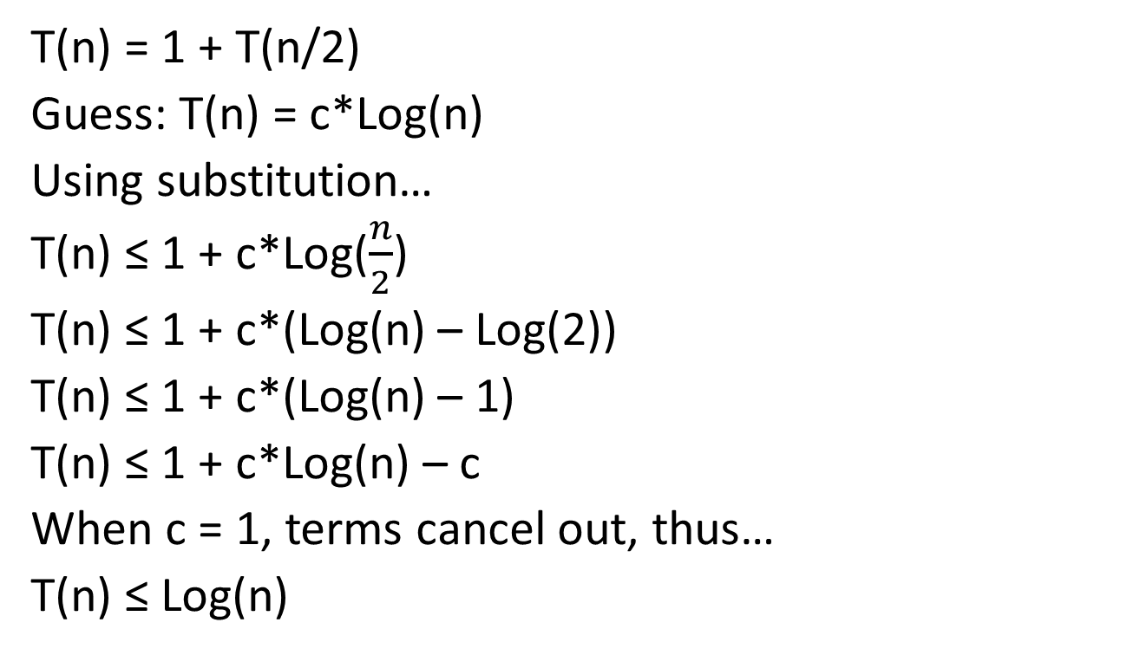
Analyzing Binary Search Approach #3: Recurrence equation
T(n) = 1 + T(n/2)
Guess: T(n) = c*Log(n)
Using substitution…
T(n) ≤ 1 + c*Log($\frac{n}{2}$)
T(n) ≤ 1 + c*(Log(n) – Log(2))
T(n) ≤ 1 + c*(Log(n) – 1)
T(n) ≤ 1 + c*Log(n) – c
When c = 1, terms cancel out, thus…
T(n) ≤ Log(n)

Slide 7
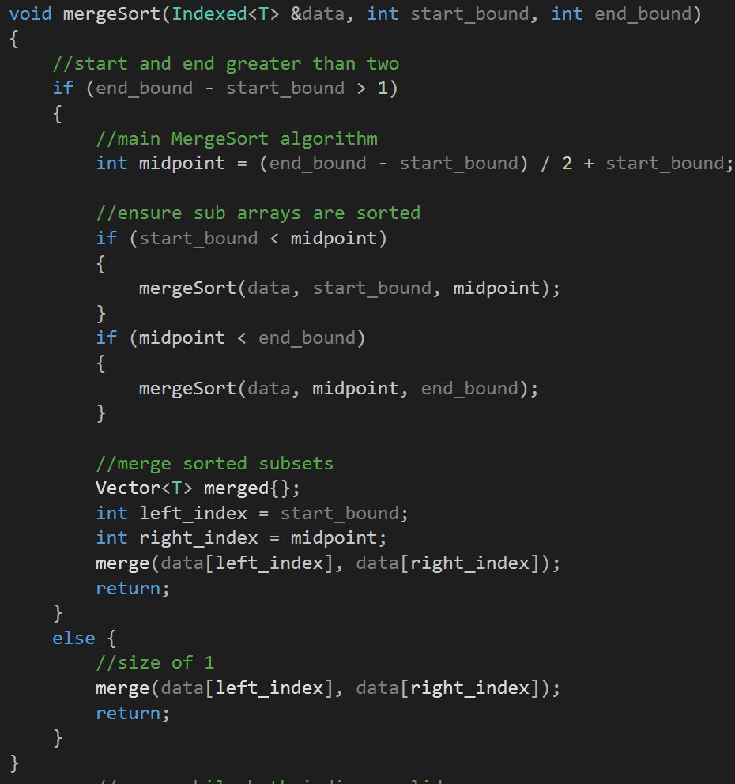
Notes:
AC Note: I adapted this from a MergeSort algorithm that I wrote a while back. To get it to fit on the screen, I had to rearrange and abstract quite a bit. As such, the algorithm might not compile or be 100% correct.

Slide 8
Analyzing MergeSort using counts
N | # Steps
1
2
4
6
8
10
12
14
16

Slide 9
Analyzing MergeSort using recursion tree:

Slide 10
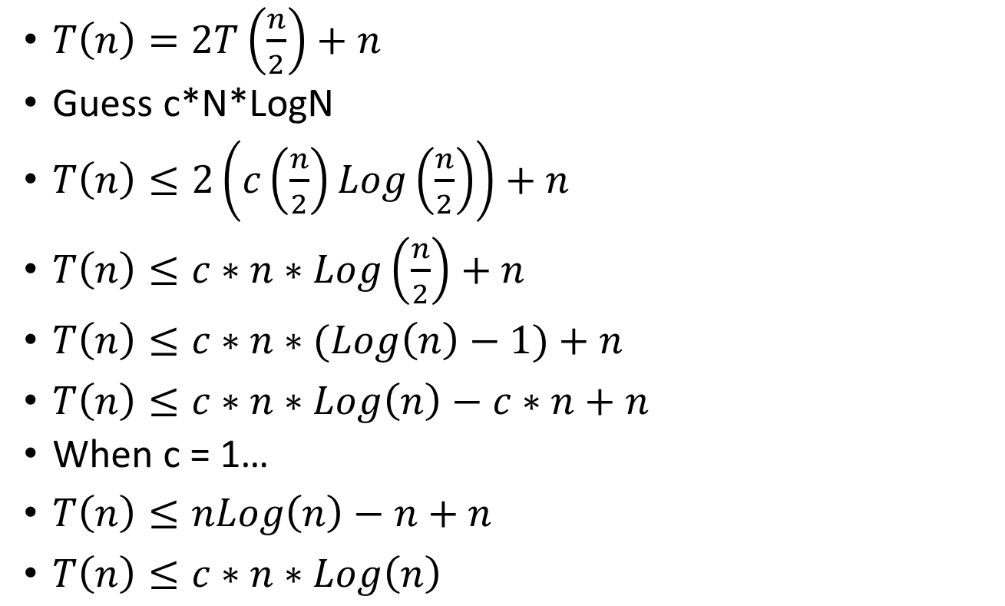
Analyzing MergeSort using recurrence relation:
$T\left(n\right)=2T\left(\frac{n}{2}\right)+n$
Guess c*N*LogN
$T\left(n\right)≤2\left(c\left(\frac{n}{2}\right)Log\left(\frac{n}{2}\right)\right)+n$
$T\left(n\right)≤c∗n∗Log\left(\frac{n}{2}\right)+n$
$T\left(n\right)≤c∗n∗(Log\left(n\right)−1)+n$
$T\left(n\right)≤c∗n∗Log\left(n\right)−c∗n+n$
When c = 1…
$T\left(n\right)≤nLog\left(n\right)−n+n$
$T\left(n\right)≤c∗n∗Log\left(n\right)$

Slide 11
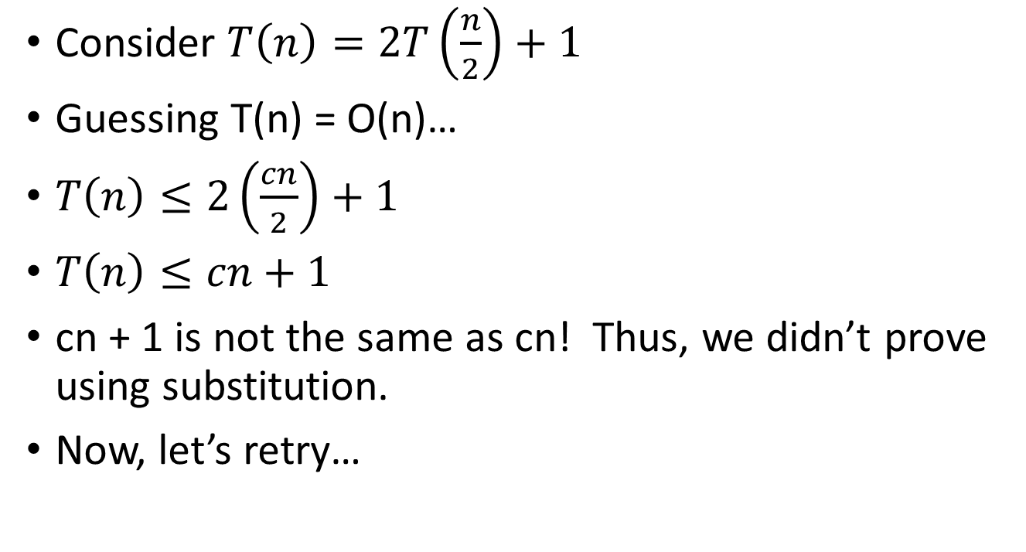
When solving via substitution, you sometimes have to insert a fudge factor.
Consider $T\left(n\right)=2T\left(\frac{n}{2}\right)+1$
Guessing T(n) = O(n)…
$T\left(n\right)≤2\left(\frac{cn}{2}\right)+1$
$T\left(n\right)≤cn+1$
cn + 1 is not the same as cn! Thus, we didn’t prove using substitution.
Now, let’s retry…

Slide 12
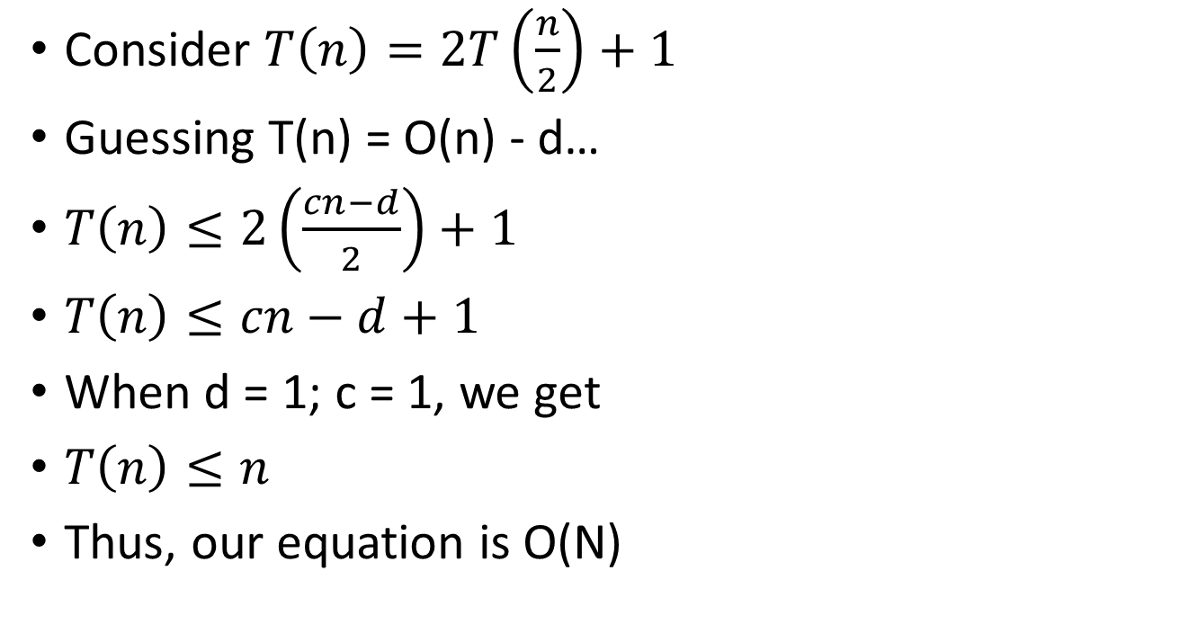
When solving via substitution, you sometimes have to insert a fudge factor.
Consider $T\left(n\right)=2T\left(\frac{n}{2}\right)+1$
Guessing T(n) = O(n) - d…
$T\left(n\right)≤2\left(\frac{cn−d}{2}\right)+1$
$T\left(n\right)≤cn−d+1$
When d = 1; c = 1, we get
$T\left(n\right)≤n$
Thus, our equation is O(N)

Slide 13

The master method is a technique that works for many recurrences.
Recurrences must be in the form $T\left(n\right)=aT\left(\frac{n}{b}\right)+f\left(n\right)$
a,b are positive constants
f(n) is asymptotically positive (i.e. it grows)

Slide 14
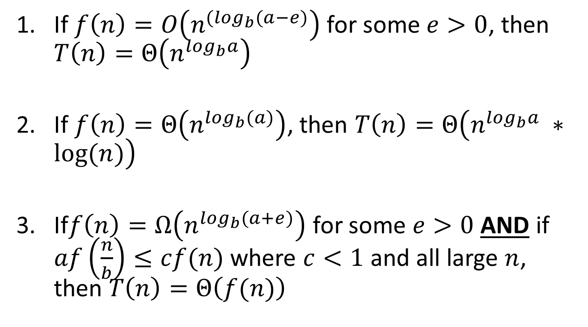
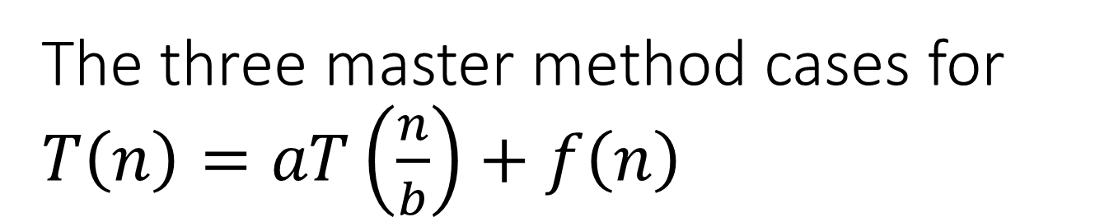
The three master method cases for $T\left(n\right)=aT\left(\frac{n}{b}\right)+f\left(n\right)$
If $f\left(n\right)=O\left(n^{{(log}_{b}(a−e)}\right)$ for some $e>0$, then $T\left(n\right)=Θ\left(n^{\log_{b}a}\right)$
If $f\left(n\right)=Θ\left(n^{\log_{b}(a)}\right)$, then $T\left(n\right)=Θ\left(n^{\log_{b}a} ∗log⁡(n)\right)$
If$f\left(n\right)=Ω\left(n^{\log_{b}(a+e)}\right)$ for some $e>0$ AND if $af\left(\frac{n}{b}\right)≤cf(n)$ where $c<1$ and all large $n$, then $T\left(n\right)=Θ\left(f(n)\right)$

Slide 15
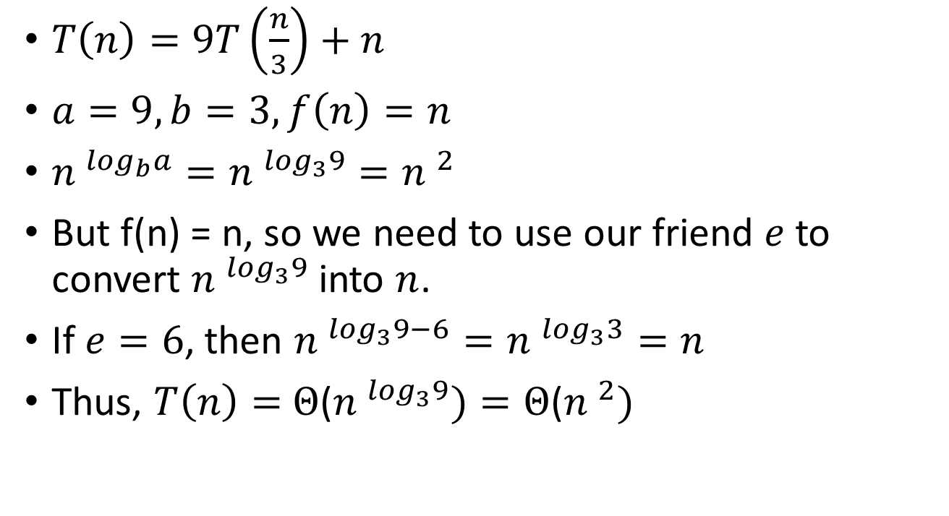
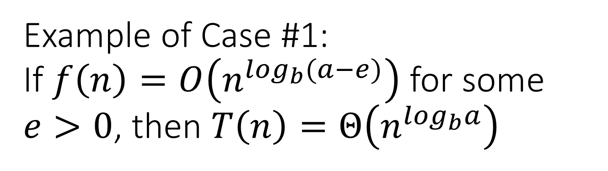
Example of Case #1: If $f\left(n\right)=O\left(n^{\log_{b}(a−e)}\right)$ for some $e>0$, then $T\left(n\right)=Θ\left(n^{\log_{b}a}\right)$
$T\left(n\right)=9T\left(\frac{n}{3}\right)+n$
$a=9, b=3, f\left(n\right)=n$
${n }^{\log_{b}a}={n }^{\log_{3}9}={n }^{2}$
But f(n) = n, so we need to use our friend $e$ to convert ${n }^{\log_{3}9}$ into $n$.
If $e=6$, then ${n }^{\log_{3}9−6}={n }^{\log_{3}3}=n$
Thus, $T\left(n\right)=$ $Θ$(${n }^{\log_{3}9})=Θ$(${n }^{2})$

Slide 16

You Try: $T\left(n\right)=2T\left(\frac{n}{4}\right)+1$

Slide 17

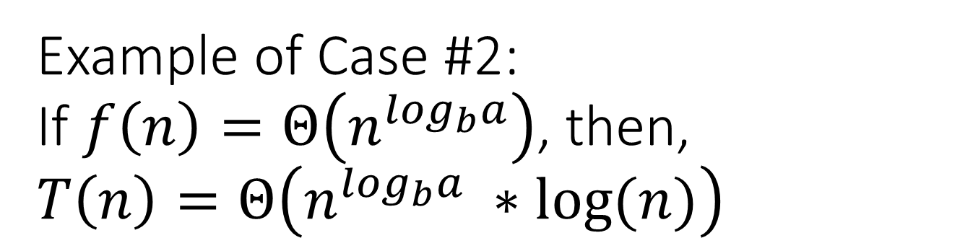
Example of Case #2: If $f\left(n\right)=Θ\left(n^{\log_{b}a}\right)$, then, $T\left(n\right)=Θ\left(n^{\log_{b}a} ∗log⁡(n)\right)$
$T\left(n\right)=T\left(\frac{2n}{3}\right)+1$
$a=1,b=\frac{2}{3},f\left(n\right)=1$
${n }^{\log_{b}a}={n }^{\log_{\frac{3}{2}}(1)}=1$
Thus, $T\left(n\right)={n }^{\log_{\frac{3}{2}}(1)}∗\log\left(n\right)=log⁡(n)$

Slide 18
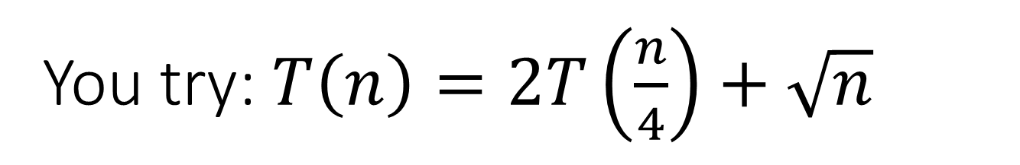
You try: $T\left(n\right)=2T\left(\frac{n}{4}\right)+\sqrt{n}$

Slide 19
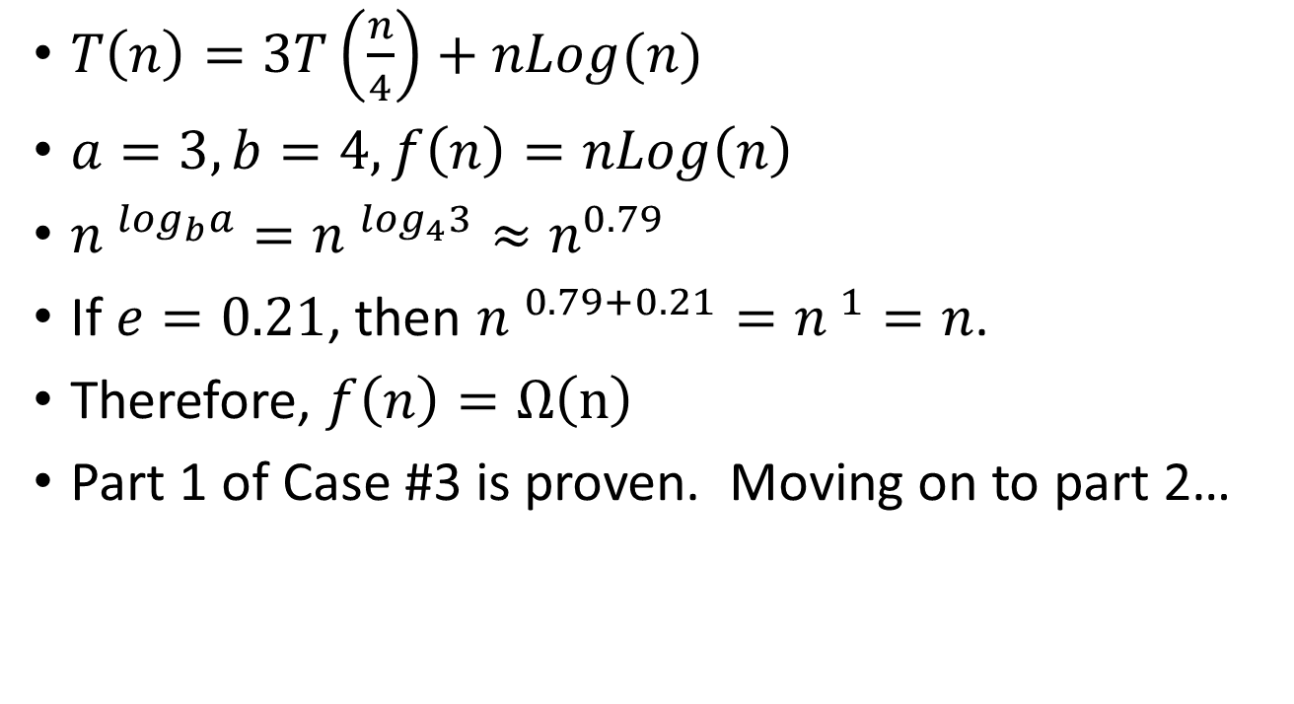
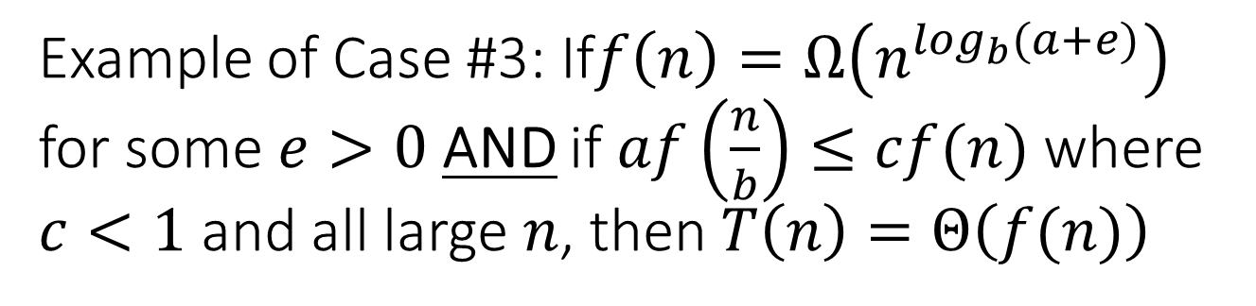
Example of Case #3: If$f\left(n\right)=Ω\left(n^{\log_{b}(a+e)}\right)$ for some $e>0$ AND if $af\left(\frac{n}{b}\right)≤cf(n)$ where $c<1$ and all large $n$, then $T\left(n\right)=Θ\left(f(n)\right)$
$T\left(n\right)=3T\left(\frac{n}{4}\right)+nLog(n)$
$a=3,b=4,f\left(n\right)=nLog\left(n\right)$
${n }^{\log_{b}a}={n }^{\log_{4}3}≈n^{0.79}$
If $e=0.21$, then ${n }^{0.79+0.21}={n }^{1}=n$.
Therefore, $f\left(n\right)=Ω\left(n\right)$
Part 1 of Case #3 is proven. Moving on to part 2…

Slide 20
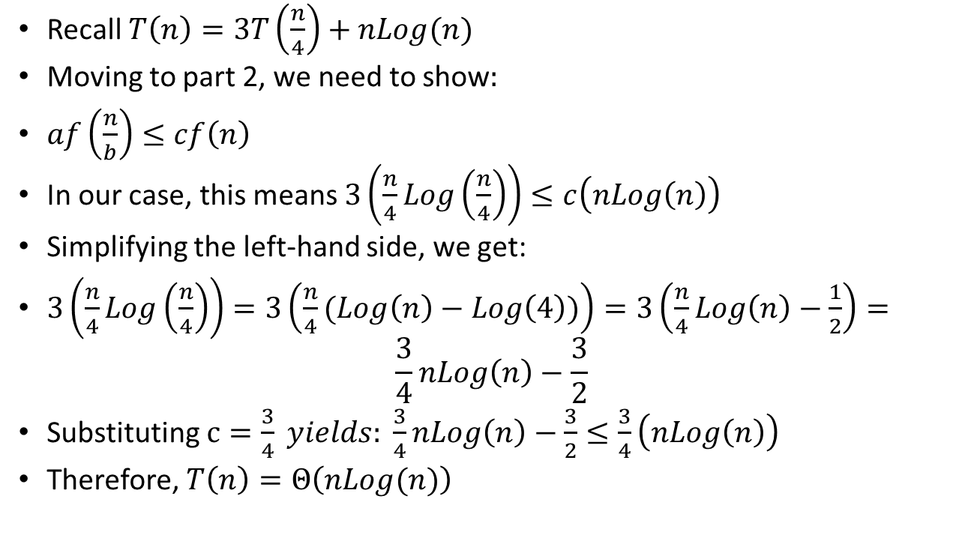
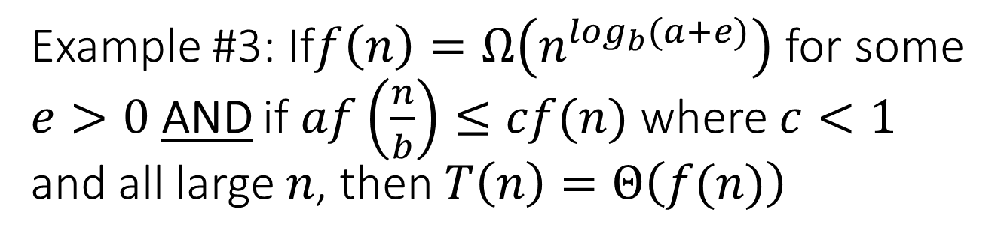
Example #3: If$f\left(n\right)=Ω\left(n^{\log_{b}(a+e)}\right)$ for some $e>0$ AND if $af\left(\frac{n}{b}\right)≤cf(n)$ where $c<1$ and all large $n$, then $T\left(n\right)=Θ\left(f(n)\right)$
Recall $T\left(n\right)=3T\left(\frac{n}{4}\right)+nLog(n)$
Moving to part 2, we need to show:
$af\left(\frac{n}{b}\right)≤cf\left(n\right)$
In our case, this means $3\left(\frac{n}{4}Log\left(\frac{n}{4}\right)\right)≤c\left(nLog\left(n\right)\right)$
Simplifying the left-hand side, we get:
$3\left(\frac{n}{4}Log\left(\frac{n}{4}\right)\right)=3\left(\frac{n}{4}(Log\left(n\right)−Log\left(4\right))\right)=3\left(\frac{n}{4}Log\left(n\right)−\frac{1}{2}\right)=$ $\frac{3}{4}nLog\left(n\right)−\frac{3}{2}$
Substituting $c=\frac{3}{4} yields: \frac{3}{4}nLog\left(n\right)−\frac{3}{2}≤\frac{3}{4}\left(nLog\left(n\right)\right)$
Therefore, $T\left(n\right)=Θ\left(nLog(n)\right)$

Slide 21

You try: $T\left(n\right)=2T\left(\frac{n}{4}\right)+n^{2}$
A = 2, B = 4, f(n) = n^2

Slide 22
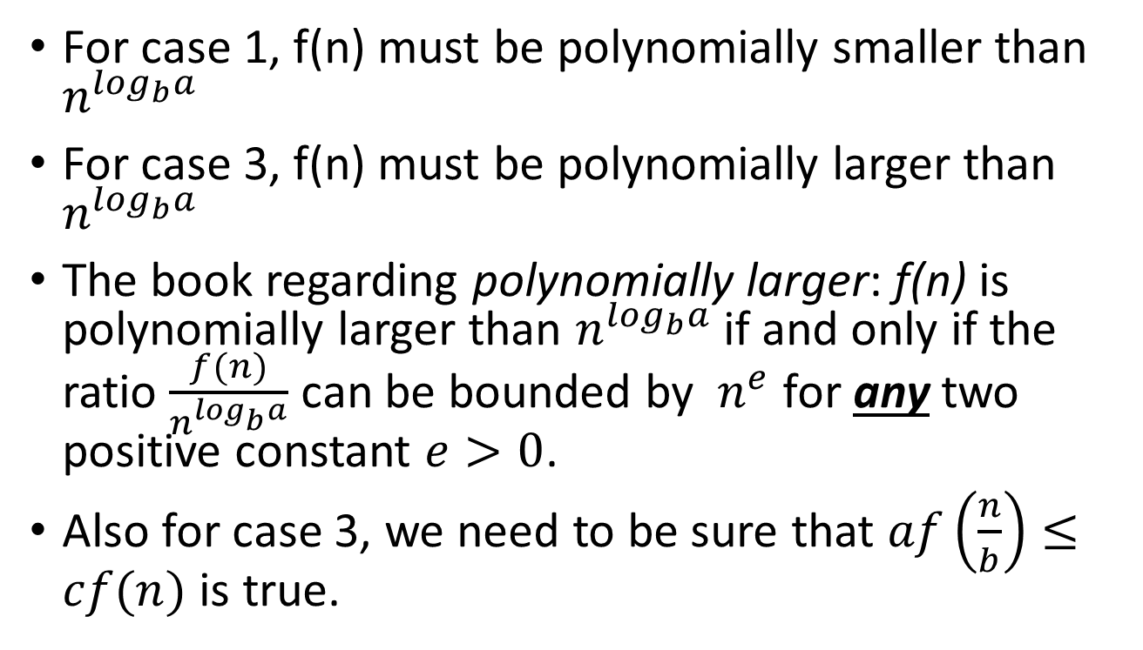
Limitations of master theorem
For case 1, f(n) must be polynomially smaller than $n^{\log_{b}a}$
For case 3, f(n) must be polynomially larger than $n^{\log_{b}a}$
The book regarding polynomially larger: f(n) is polynomially larger than $n^{\log_{b}a}$if and only if the ratio $\frac{f(n)}{n^{\log_{b}a}}$ can be bounded by $n^{e}$ for any two positive constant $e>0$.
Also for case 3, we need to be sure that $af\left(\frac{n}{b}\right)≤cf(n)$ is true.

Slide 23
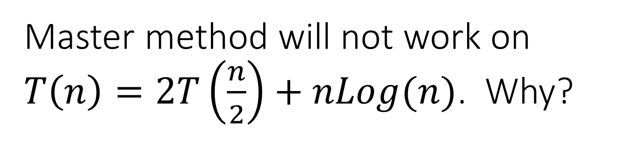
Master method will not work on $T\left(n\right)=2T\left(\frac{n}{2}\right)+nLog(n)$. Why?

